Slide 1
District 2-S3 Charities, KidSight Program +
Welch Allyn Certification & Vision Screening Training

Slide 2
Mission Statement
Consistent with the goal of KidSight USA the KidSight Program’s primary focus is safeguarding the vision of children, especially those of 6 months to 6 years. In particular detection of risk factors for amblyopia, a treatable disorder if diagnosed at an early age.

Slide 3
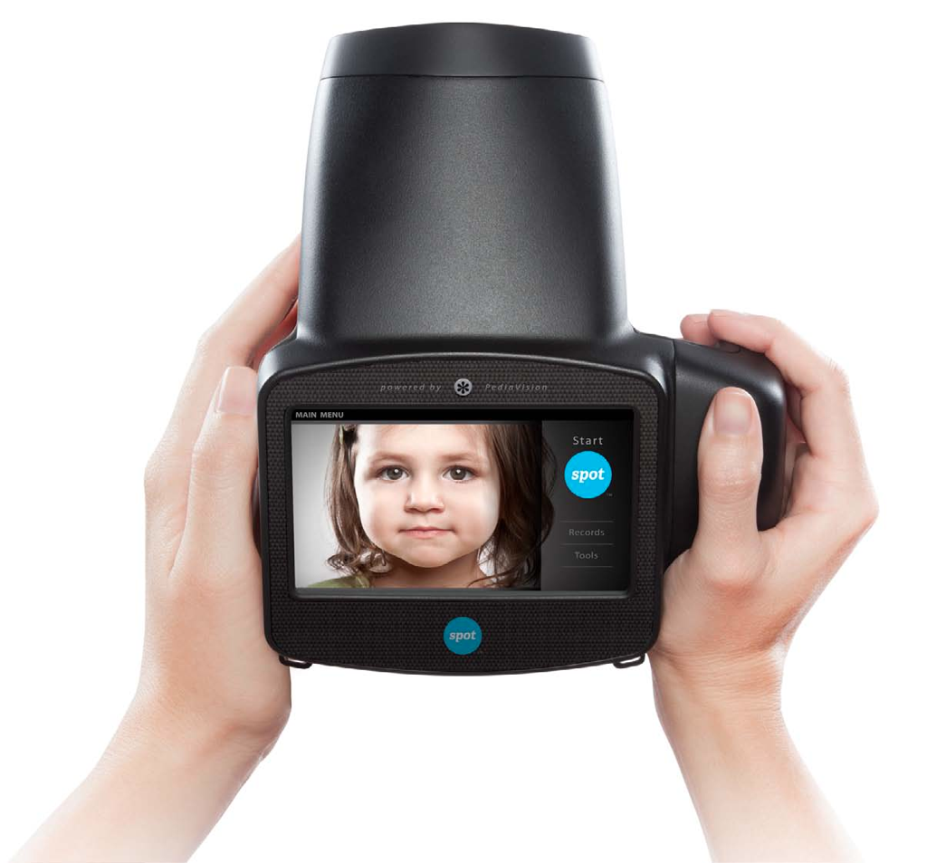
Welch Allyn - Spot VS100 Certification Program

Slide 4
Why screen children’s vision?
Vision problems are the leading handicap of childhood
80% of what a child learns is visual
Vision problems can lead to loss of sight, learning difficulties, and delayed development
Children are not always aware of problem
4
Notes:
Vision disability is the single most preventable disabling condition among school-age children, according to the U.S. Centers for Disease Control and Prevention (CDC). Approximately 80 percent of what children learn in their early school years is visual, so if they can't see a teacher's writing on the blackboard, they will struggle. In addiiton, today’s school world has many “tech” items that children work on – computers, ipads, etc.
Children with vision problems are often too young to know and understand that the way they see the world is not the way everyone else sees it. This, along with the fact that vision problems usually don’t cause physical pain, means that many vision issues go undetected

Slide 5
Screening vs. Examination
Screening
Identifies need for eye exam
Identifies problems early
Provides eye health information
Results in referral to eye care professional
Examination
Examines subject for eye disorders and disease
Diagnoses problems
Prescribes treatment
5
Notes:
QUESTION #5
IMPORTANT to note that we NEVER diagnose. It always a screening to IDENTIFY.
We don’t print results or hand out any results or discuss results with parents or adult being screened. We ONLY give our LC sheet that indicates PASS or REFER.
If eye professional wants to request copy, we will email file directly to doctor office.

Slide 6
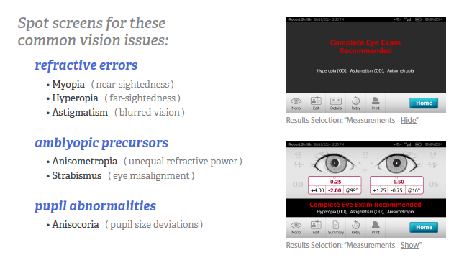
Common Vision Issues
6
Notes:
QUESTION #5
IMPORTANT to note that we NEVER diagnose. It always a screening to IDENTIFY.
We don’t print results or hand out any results or discuss results with parents or adult being screened. We ONLY give our LC sheet that indicates PASS or REFER.
If eye professional wants to request copy, we will email file directly to doctor office.

Slide 7
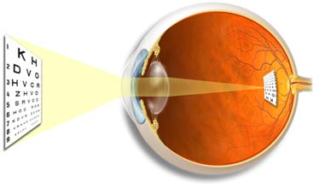
Common Eye Problems: Refractive Error
Defect in optics of the eye resulting in lack of precise focus of light rays on retina causing a blurred image
Nearsightedness (Myopia)
Nearsightedness is when light entering the eye is focused incorrectly, making distant objects appear blurred
Farsightedness (Hyperopia)
Farsightedness is greater difficulty seeing near objects
than distant objects
Astigmatism
Astigmatism causes blurred vision from any distance, typically caused by a misshaped cornea
7
Notes:
QUESTION # 4
In an eye with normal vision, focusing ability of the cornea and lens is matched to the length of the eye. Your eyes are therefore able to focus an image precisely on the retina.
Myopia In myopia, your eyes focus the image ahead of the retina. This usually occurs with an eyeball that is longer or a cornea that is steeper than normal.
hyperopia, your eye focuses the image behind the retina. This usually occurs if your eyeball is too short or the cornea has too little curvature.
Astigmatism is a condition where vision is disordered (blurred, unfocused, fuzzy) because the cornea (the front surface of the eye) or lens, which is located behind the cornea, has an abnormal or irregular curve (misshaped)

Slide 8
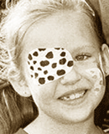
Amblyopia (Lazy Eye)
Reduced vision in an eye that has not
received adequate use during early childhood
Affects 2-3% of population
Results in permanent vision loss, if not treated early
Caused by unequal refractive error, strabismus or other factors
Early intervention is extremely important with amblyopia
If identified before 5 years old it can typically be corrected with a simple eye patch or special glasses
Between the ages of 6-8 years old amblyopia treatment will typically require surgery
If the issue is identified after 8 years old the damage may be untreatable
8
Notes:
QUESTIONS #4, 12
Dimness of vision - in latin. Amblyopia is a condition that occurs when there is a reduction of vision in one eye. Amblyopia, which is often called lazy eye is most common in infants and children, but it can also occur in adults.
When amblyopic precursors are caught at an early age there is a 95% chance that child will almost completely regain their sight. With Spot you can begin screening children at 6-months of age, this head start should help ensure that children don’t unnecessarily suffer from preventable or treatable eye abnormalities.

Slide 9
Strabismus (Gaze deviation)
Eyes that are misaligned or not straight
Affects one or both eyes
Constant, intermittent, or alternates eyes
Affects about 2% of population
Results in permanent vision loss, if left untreated
Lingo Alert! You may hear strabismus referred to as “walled eye” (eye(s) turning out), or “crosseyed” (eye(s) turning in)
9
Notes:
QUESTION #4, 12. 14

Slide 10
Anisocoria & Anisometropia
Anisocoria is a condition characterized by an unequal size of the pupils
This has the potential be a precursor for a neurological issue
Anisometropia is the condition which the two eyes have unequal refractive power
Example: one eye is slightly myopic while the other is severely myopic. (greater than a 1 diopter variance) Note that a little variance is common
8
Notes:
QUESTIONS # 4, 8, 14

Slide 11
Special Notes
SPOT does not screen for Presbyopia
Presbyopia is caused by an age-related process, beginning at around age 40, when people experience blurred near vision when reading, sewing or working at the computer. This differs from astigmatism, nearsightedness and farsightedness, which are related to the shape of the eyeball and are caused by genetic and environmental factors. Presbyopia generally is believed to stem from a gradual thickening and loss of flexibility of the natural lens inside your eye.
You can't escape presbyopia, even if you've never had a vision problem before. Even people who are nearsighted will notice that their near vision blurs when they wear their usual eyeglasses or contact lenses to correct distance vision.
Presbyopia Symptoms and Signs
When people develop presbyopia, they find they need to hold books, magazines, newspapers, menus and other reading materials at arm's length in order to focus properly. When they perform near work, such as embroidery or handwriting, they may develop headaches, eye strain or feel fatigued.
SPOT captures subjects 97% of the time
Pupil size must be 4mm
8
Notes:
QUESTIONS # 4, 8, 14

Slide 12
12
Notes:
HANDOUTS pgs 9-22

Slide 13
Main Menu-Home Screen
When Spot is powered on, the main menu or “Home Screen” will appear. If Spot is connected to a network, the network name and IP address will be visible in the upper left corner in the black bar.
3 Data Entry Options
1. Start: To begin the data entry and screening process, select the START button, this will allow you to:
Enter subject information (ID, first and last name,gender, and age/DOB) * Age or DOB is required to screen. Somewhat time consuming
2. Instant Screening: To begin instant screening, with no personal subject data, select an age range on the Home screen. You can enter data after screening if desired.
3. Select from Queue: Subject data can be preloaded prior to testing (USB).
13

Slide 14
3 Data Entry Option Screens
10
Notes:
QUESTION # 11
This sequence is important when conducting a screening and printing results on location. By powering up the wireless router, then printer, then Spot, you give Spot a chance to identify the “live” Spot network.

Slide 15
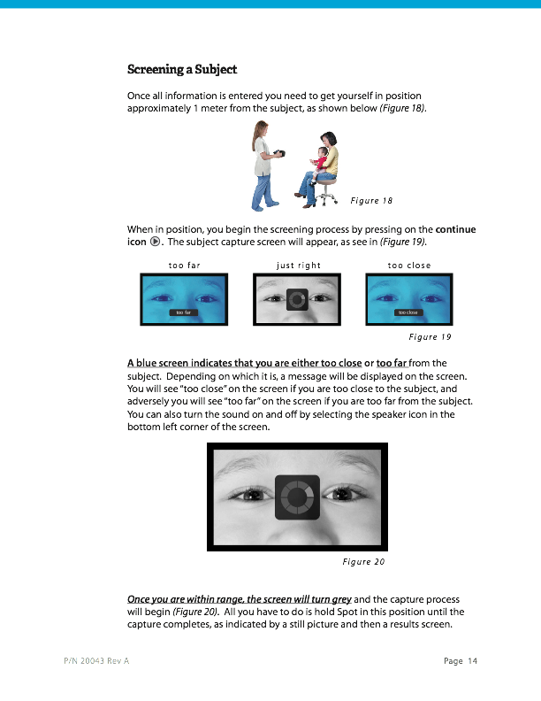
15
Notes:
QUESTION # 1
Volume signal - lower left corner icon to turn off or on…….
Dark room is important

Slide 16
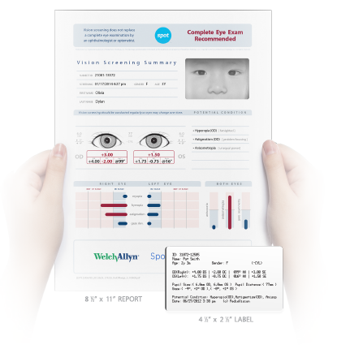
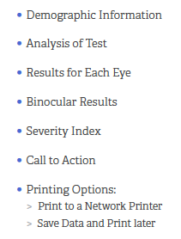
Printed Results
16
Notes:
QUESTION # 1
Volume signal - lower left corner icon to turn off or on…….
Dark room is important

Slide 17
Helpful Hints
How to get best results from screenings:
Distance to shoot from –
1 meter (a little over one yard from patients eyes, 3.3 feet).
The child may sit in the parents lap if they are more comfortable doing so.
Lighting; Dim is best –
It is very important to have minimal to no direct bright lights, this includes sunlight and fluorescent lights.
Try using sunglasses when pupils are too small. First try screening through them, if that doesn’t work remove the glasses and try again without them
The pupils need to be between 4-9mm to capture a screening. If the pupils are too small you will need to reduce the light in the room, if they are too large you can introduce light for the opposite effect
Technician stance when screening –
Keep handheld device at “eye” level with the patients eye’s – not above or below so as to get the most accurate reading
The ideal screening position is standing up with one foot slightly ahead of the other. This will also the screener to gently move in or out to reach the correct screening distance.
Distractions to a minimum –
Minimize all external distractions so that the child will watch the handheld device and their eyes will be focused straight ahead.
Create a “quite zone”.
Patients/Childs head angle –
it is best to have the child’s head squarely faced toward the handheld device and not angled.
17
Notes:
1st Bullet - QUESTION # 1 – 3 ft 3 in
2nd Bullet – QUESTION # 10 – DIM lighting

Slide 18
Interpreting Results
Screening Complete (All measurements in range)
All readings are below criteria thresholds and the child does not require follow-up care
Complete Eye Exam Recommended
One or more readings are above criteria thresholds and should therefor be referred for follow-up care by an eye care specialist
Lions should not diagnose a patient when a “Complete Eye Exam Recommended” occurs:
Only the doctor should interpret the results if they feel comfortable doing so – this is a screening tool only and the vision diagnosis should be left up to the eye specialist.
18
Notes:
QUESTION # 9

Slide 19
Support
Welch Allyn is dedicated to providing the necessary support to ensure a successful vision screening program.
If you are experiencing problems with the Spot Unit during a screening, you may contact the Welch Allyn Technical Support Center at
800-535-6663. Their office is open Monday through Friday 7 AM to 7PM.
If Welch Allyn is unable to correct the problem with your Spot over the phone, please contact Gary Fuchs at 254-482-0611 or garyfuchs53@yahoo.com. He will make arrangements to have your unit returned for repair and send you the shipping paperwork you need. When it is repaired, it will be returned directly to the Custodian of that unit. Please do not try to return the unit yourself, as these units must be returned under the warrantee the District holds with Welch Allyn.
19

Slide 20
KidSight Program Rules
Proper parental permission forms should be provided during vision-screening events. Downloadable permission forms for public vision-screenings can be found on our website – lionsdistrict2s3kidsight.org

Slide 21
KidSight Program Rules
Only Lions that are Welch Allyn certified vision-screeners are allowed to operate the Spot Unit. Without certification a vision-screening volunteer is not authorized to vision-screen, handle or demonstrate the Spot unit.
You can however ask other volunteers to help with distributing consent forms, lining up the children, giving out stickers, etc.

Slide 22
KidSight Program Rules
Our web site has all of the forms and instructions you need to have a screening.
Go to the “Screening Resources” page and use the Screening Documents pull down. You will find forms and screening information on the left side, and the Screening Results section on the right. All of your screenings should be reported on this page.

Slide 23
KidSight Program Rules
Our insurance policy covers fire and theft.
If a Spot unit is damaged, and if repairable, the cost to the club that caused the damage (custodial or borrowing) is the $500.00 deductible associated with the warrantee.
If the Spot unit is not repairable the club that caused the damage is responsible for the full replacement cost of the Spot unit.

Slide 24
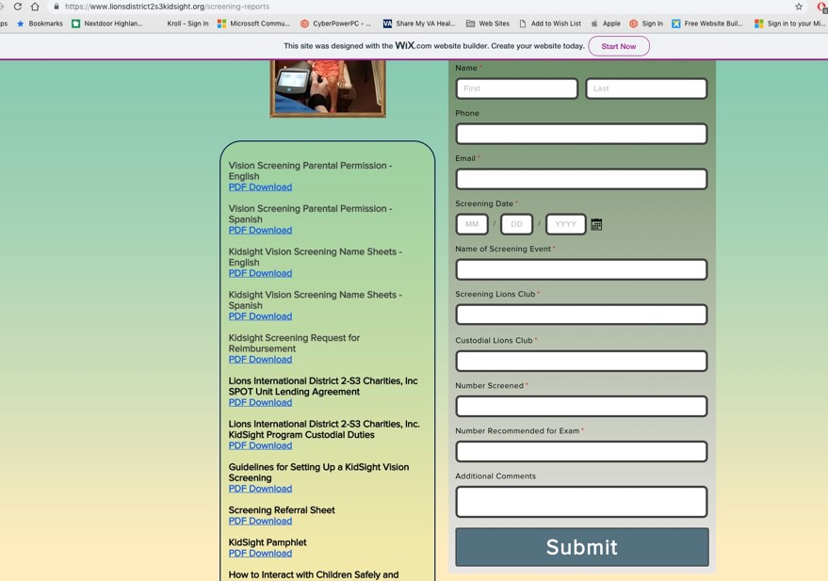
SUBMIT YOUR SCREENING RESULTS ON THE WEBSITE AT SCREENING RESOURCES/SCREENING DOCUMENTS

Slide 25
HOW TO INTERACT WITH CHILDREN SAFELY AND EFFECTIVELY
Make it “Fun”.
NEVER be alone in a room or confined space with a child.
Have a teacher, school nurse, or teacher’s aide help line the children up and keep them occupied until it’s their turn.
Try not to have the waiting children interact with the child being screened.
Don’t have too many children lined up at one time
Smile at the children all the time.
Do not show frustration if a child is not cooperating. Retest on another day if necessary.
Always tell the children that they did a “Great Job”.
Do not touch children. If they need direction in standing/sitting in the proper location or prompts such as a touch on the shoulder, have the school personnel do this. Do not do it yourself.
Give clear instructions as to where the child should look. Again, make it a game. When the screening results are obtained, tell the child “You win”.
If you give the children stickers after the screenings, you should hand it to them so the child can place it on himself or herself. You may hand the stickers to the school personnel for placement, but do not place it on the child yourself.
Be mindful of what you say during a screening. Remember that you represent the Lions and children will repeat what they hear to their parents and teach

